Slide 1

Data Governance

Slide 2
Table of Contents
Training Purpose
Overview of Data Governance
How Data Governance Fits into a Migration to CEDS
CEDS Tool Usage to Aid Data Governance Processes
Creating a Use Case
Resources

Slide 3
In This Training
This training provides:
A basic understanding of how CEDS approaches governance across the PK-20W+ data domains
Ways to utilize CEDS tools to aid in governance processes.
Using Align to help identify gaps in elements, element definitions and/or option sets and their definitions
Understanding the gaps resolution process
Creating and submitting Use Cases to the Open Source Community (OSC)

Slide 4

What is Data Governance?

Slide 5
What is Data Governance?
Data governance focuses on
data availability,
data quality, and
data security
through policies and processes that promote review and definition of data elements across all stages of the data lifecycle.
This includes intentional review or creation of:
Metadata
Data Architecture
Data Security
Data Warehouse
Reporting and Usage
Documentation/Data Dictionaries

Slide 6
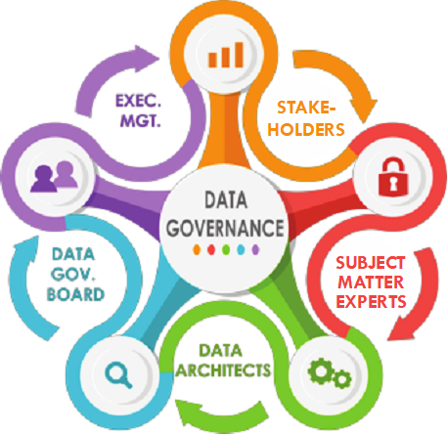
Who is responsible for data governance?

Slide 7
Who is responsible for data governance? YOU ARE!
Data Governance is a Team Effort!
Data Stewards – Monitor a data universe across its lifecycle
Data Architects, Data Modelers, Data Engineers, etc.
Data Analysts, Reporting Analysts, Researchers, etc.
Stakeholders, Media, Data Consumers, etc.
Data Governance Board
If you collect, load, or use data, you have a role to play!

Slide 8
Benefits of Data Governance Policies
Dynamic decision making
Avoid bottlenecks by streamlining decision making
Improved understanding of the data
Intentional and Focused Data Modeling, Loading and Usage
Improve or maintain data quality
Shared understanding of data collections, reporting and usage
Building Trust
Improve consistency and reliability of data
Allows or simplifies self-service by stakeholders

Slide 9
Where Does Data Governance Fit into a Migration to CEDS?

Slide 10
The High-Level Process Steps of a Migration to CEDS
Identify & Load Data Elements to CEDS Align Tool
Map & Align Data Elements in CEDS Align tool
Identify & Resolve Gaps
Database modeling and design (DWH/Report Tables)
ETL Development and Validation (DWH/Report Tables)
Ideally, migration of elements smoothly proceeds through each step, but it's possible and even likely, that at some point, an element is missed or modified leading to reconsideration. This can be an iterative process.

Slide 11
Identify & Load Data Elements to CEDS Align Tool
What is 'Align'?
The CEDS Align Tool provides a user-friendly interface that allows us to map (align) existing data dictionaries to their CEDS counterpart.
Steps to Align - How to approach Align as a Team
CEDS Screens – Guidance and Navigation
TIP! Having a team of Subject Matter Experts will increase accuracy of mapping on the first-pass!
TEAMWORK MAKES THE DREAM WORK!

Slide 12
What if an element doesn't align?

Slide 13
Identifying, Documenting and Tracking Gaps
What is a "Gap?"
Sometimes there is no clear CEDS equivalent for an existing state element or option set. If so, a "gap" in the national standard has been identified.
A team reviews each gap to document details of the gap, recommend a resolution and gather feedback utilizing the Master Gaps Spreadsheet.
The ideal team member combination would include individuals with expertise in:
The Subject Matter/Content Area
Data Governance
CEDS elements/domain structures

Slide 14
The Master Gaps Spreadsheet
The Master Gaps Spreadsheet is a summary of the elements and/or options that did not map with a high match rate between the source data and CEDS.
At a minimum, it should:
Identify and describe the gap
Propose a solution
Document who was involved in the discussion(s)
Share and capture feedback from management (if necessary)

Slide 15
Identify the Best Approach to Resolve the Gap
Our goal is to minimize the amount of state extensions in our database, but we recognize that not all state elements are useful to the national community.
Resolve the gap within the state
Resolve the gap by changing CEDS
Recommend a mapping or transformation that brings state data into alignment with CEDS.
Create a state-specific extension for an element or option.
Routed for internal review.
Recommend expansion to CEDS – suggesting new element(s) or option(s) or modifications to existing elements/options.
Submit a proposed use case to the CEDS Open-Source Community for review.
Partner with other state(s) with similar needs to create the new element/option.

Slide 16
Gap Resolution can be Challenging
Some challenges you may encounter:
A field in the source data has no equivalent element in CEDS.
A field in the source data relies on an option set, but not all options have an equivalent option in CEDS.
A field in the source data is similar to a CEDS element but will require significant transformations to match exactly.
Multiple fields in the source data appear to map to the same one CEDS element.
A field in the source data relies on one option set but the options appear to map to different elements in CEDS.
Possible resolutions:
Propose a new CEDS element, or
Propose modifying an existing CEDS element (ex: adding to the option set), or
Use a state extension, or
Use transformations to make it work, or
Adjust state definitions to match, or
Exclude (do not migrate).
Choosing the best way to resolve a gap can be tricky. The Gap Resolution Scenarios PowerPoint walks through several challenges and ways to resolve them in more detail. If you will be part of the gap resolution process, be sure to read it as well!

Slide 17
Creating a Use Case
When all efforts to find a matching element or option within the CEDS domains have been unsuccessful AND it's agreed that the element or option would be useful to other states, it is time to create a Use Case to gather feedback from the Open Source Community.
Purpose of a Use Case
Propose a new element to be added in the CEDS model,
Modify an existing element definition
Modify/add to an option set
CEDS Webinar Series on Learning How to do a Use Case – A robust instructional video series hosted by AEM

Slide 18

Wrap-up
A quality data governance program ensures the availability, reliability, integrity, and security of data in any organization.
But Be Aware!
Re-work may be part of the game as we progress through data modeling, adding additional data sets and allowing our process to mature!

Slide 19
Additional Resources
CEDS National Training – An Intro to CEDS – Overview of CEDS intent and purpose
CEDS Resources –
CEDS Home Page – contains links to OSC opportunities
CEDS Data Governance recommendations: Common Education Data Standards (CEDS)
Using CEDS Data Governance
SLDS Guide: Developing Effective Data Policies and Processes
US Ed
EDFacts Data Governance Board (PDF)

